Slide 1

Analyzing And Forecasting Restaurant Inspection Grades in NYC
Ansuman Patnaik

Slide 2
About this Project
Objective: Analyze NYC restaurant inspection data and business acceleration data to understand factors affecting inspection grades.
Key Context: NYC Department of Health and Mental Hygiene (DOHMH) assigns grades to restaurants based on health and safety inspections. These grades influence public perception and business success.
Goals: Identify patterns and trends in inspection data. Determine factors influencing restaurant inspection grades. Develop predictive models for forecasting future inspection grades.
Business Impact: Insights can help restaurants improve compliance and streamline operations. Publicly available grades affect customer trust and business reputation. Results may guide regulatory bodies and business stakeholders in decision-making and strategy.

Slide 3

Our Approach
Collection and loading
Data Preprocessing for Inspection Dataset
Data Preprocessing for Business Acceleration Dataset
Exploratory Data Analysis for Inspection dataset
Exploratory Data Analysis for Business Acceleration dataset
Post Data preparation EDA
Merging both Datasets
Time Series Analysis of Inspection Data
Feature Engineering
Important features for each component
Model Construction & Evaluation
Model comparison and Selection
Hyperparameter tuning
Model interpretation using LIME
Conclusion
Overall Observation

Slide 4
Inspection Data (Dataset 1)
Column | Description | Data Type
CAMIS | Unique identifier for a business (Commercial And Miscellaneous Identification System) | Integer
DBA | "Doing Business As" name of the establishment | String
BORO | Borough where the business is located | String
BUILDING | Building number for the establishment's address | String
STREET | Street name for the establishment's address | String
ZIPCODE | Zip code where the establishment is located | Float
PHONE | Contact phone number for the establishment | String
CUISINE DESCRIPTION | Description of the cuisine type served at the establishment | String
INSPECTION DATE | Date when the inspection took place | String
ACTION | Description of the action taken during inspection | String
VIOLATION CODE | Code representing a specific health/safety violation | String
VIOLATION DESCRIPTION | Detailed description of the violation | String
CRITICAL FLAG | Indicates if a violation was deemed critical ("Not Applicable" or other values) | String
SCORE | Score received during the inspection | Float
GRADE | Grade received by the establishment ("A", "B", "C", etc.) | String
GRADE DATE | Date when the grade was issued | String
RECORD DATE | Date when the record was last updated | String
INSPECTION TYPE | Type of inspection conducted (e.g., Cycle Inspection, Initial Inspection) | String
Latitude | Geographical latitude coordinate of the establishment | Float
Longitude | Geographical longitude coordinate of the establishment | Float
Community Board | Community board district where the business is located | Float
Council District | Council district where the business is located | Float
Census Tract | Census tract for the location of the business | Float
BIN | Building Identification Number for the establishment | Float
BBL | Borough-Block-Lot identifier for the establishment | Float
NTA | Neighbourhood Tabulation Area where the establishment is located | String
Location Point1 | Geographic location (latitude, longitude) for mapping (possibly not used) | String

Slide 5
Business Acceleration (Dataset 2)
Column Name | Description | Data Type
DBA | "Doing Business As" name of the establishment | String
Establishment Street | Street address for the establishment | String
Establishment Zip | Zip code where the establishment is located | Float
Establishment Borough | Borough where the establishment is located | String
Business Sector | Industry sector to which the establishment belongs | String
Establishment Category | Category of the establishment (e.g., Restaurants, Retail) | String
Type of Cuisine | Description of the cuisine type served at the establishment | String
Number Of Employees | Number of employees in the establishment | Float
Actual Opening Date | Date when the establishment was opened | String

Slide 6
Challenges Faced
Inspection Data
Business Acceleration
Data Inconsistency: Inspection data had inconsistent formats, especially for dates and categorical variables. This required data pre-processing to standardize and ensure uniformity.
Missing Values: Several columns had significant missing data, such as "Grade," "Grade Date," and "Violation Description." This required imputation and filling techniques to create a complete dataset for analysis.
Outliers: Inspection scores and other numerical fields exhibited outliers, potentially skewing the results. The challenge was to identify and address these outliers without losing valuable data.
Redundancy and Duplicates: The dataset had some redundant or duplicated rows. This needed to be resolved to ensure data integrity and avoid misleading insights.
1. High Proportion of Missing Data: Key columns, such as "Business Sector," "Establishment Category," and "Type of Cuisine," had high rates of missing data. Imputation and other pre-processing methods were employed to handle these gaps.
2. Numerical and Categorical Outliers: The "Number of Employees" and "Establishment Zip" columns had significant outliers, requiring capping or other techniques to ensure reliable data distribution.
3. Data Types and Conversion: Columns containing ZIP codes and date information were not consistently formatted, leading to challenges in processing and analysis. These fields needed appropriate data type conversions to align with the project requirements.
4. Unique Identifiers and Merging: The unique identifier (DBA) across the datasets needed careful handling to avoid data loss during merging. Ensuring accurate merging was crucial to maintaining a complete and coherent dataset.

Slide 7
Pre-processing Steps for Inspection Data
Data Cleaning: Removed irrelevant columns and rows with excessive missing data.
Handling Missing Values: Imputed categorical columns with the mode and numerical columns with mean/median.
Outlier Removal: Removed numerical outliers using the interquartile range (IQR) method.
Data Transformation: Converted categorical columns to 'category' data type and applied one-hot encoding.
Feature Engineering: Extracted date-based features and additional indicators for critical data points.
Duplicate Handling: Checked and removed any duplicate rows.
Data Standardization: Standardized numerical columns using StandardScaler for consistency in modelling.

Slide 8
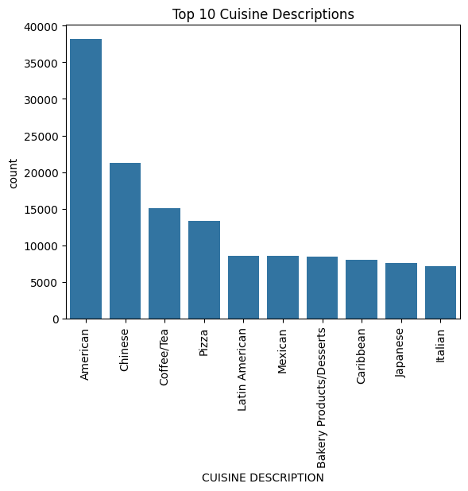
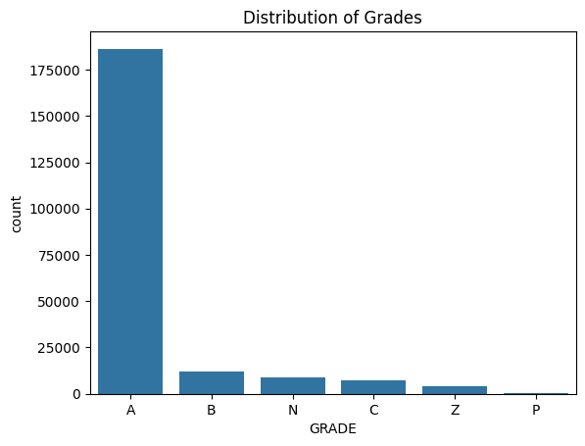
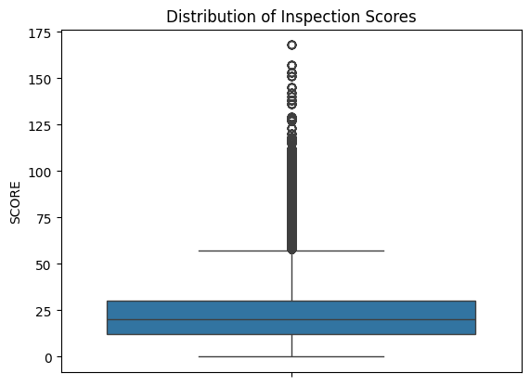
Exploratory Data Analysis for Inspection Data

Slide 9
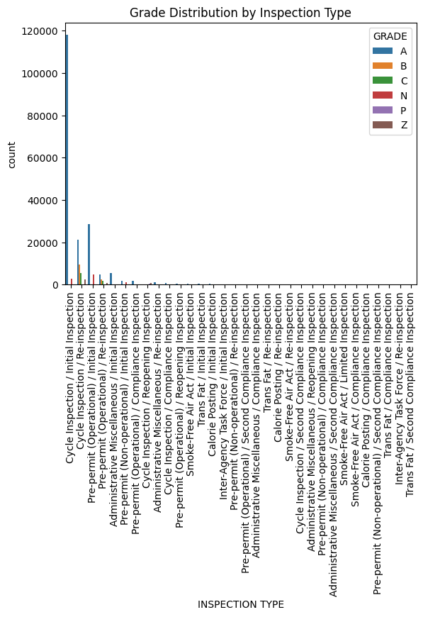
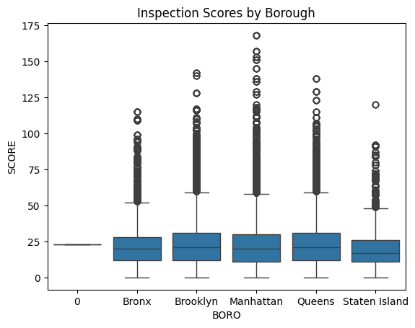
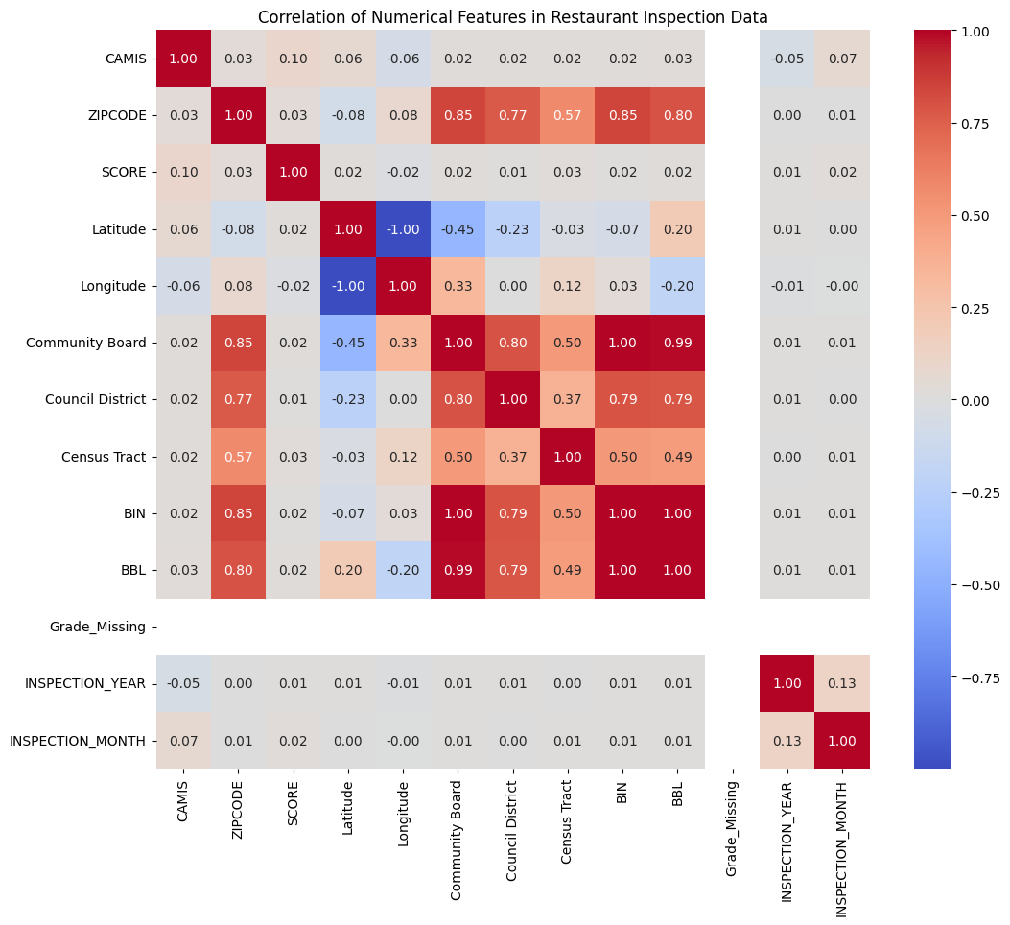
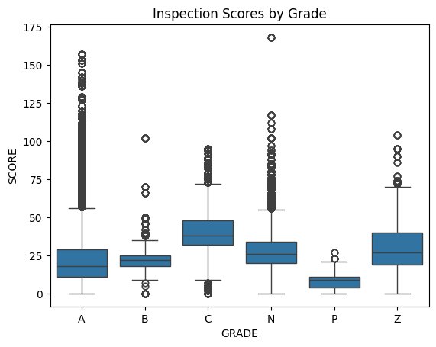
Exploratory Data Analysis for Inspection Data

Slide 10
EDA Summary for Inspection Data
Data Overview: Examined 219,276 records with 27 columns, including information on restaurant inspections, scores, grades, and violation details.
Missing Values: Identified missing data in key columns, imputed with mode for categorical and mean for numerical features.
Outliers Detection: Discovered and handled outliers in numerical columns like SCORE, Latitude, and Longitude using the interquartile range (IQR) method.
Distribution Analysis: Observed skewed distributions in key columns like SCORE, with most scores high and a few lower scores indicating non-compliance.
Correlation and Feature Importance: Analysed correlations between numerical features and identified critical variables, such as SCORE, ZIPCODE, and INSPECTION DATE.
Trend Analysis: Detected trends in inspection dates, showing a sharp increase in inspections from the late 1990s to the 2020s, with periodic peaks suggesting seasonal or event-driven patterns.
Geographical Insights: Analysed inspection scores by borough, identifying consistent performance with some variability across different areas.

Slide 11
Pre-processing Steps for Business Acceleration Data
Data Cleaning: Dropped irrelevant or redundant columns.
Handling Missing Values: Imputed categorical columns with mode and numerical columns with mean/median.
Data Transformation: Converted ZIP codes to strings, cleaned leading/trailing spaces, and standardized formats.
Handling Outliers: Capped or removed numerical outliers based on the interquartile range (IQR) method.
Feature Engineering: Created additional features from existing columns, such as binning employee counts into ranges.
Data Standardization: Applied StandardScaler to numerical columns for modelling consistency.
Duplicate Handling: Checked and removed duplicate rows to ensure data integrity.

Slide 12
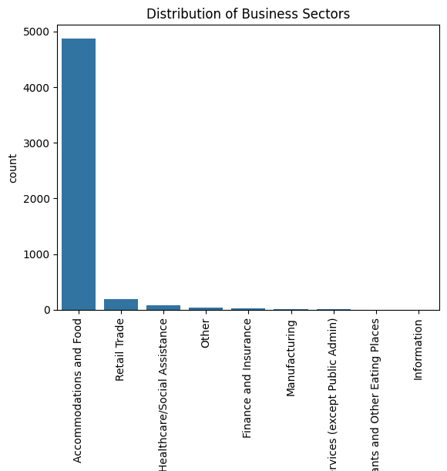
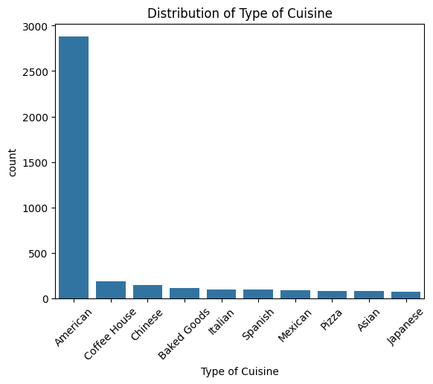
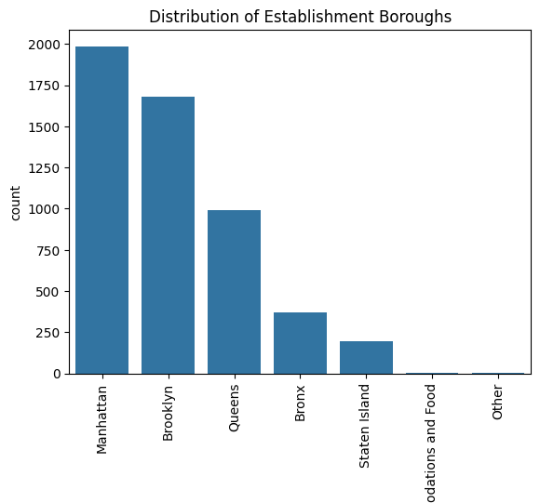
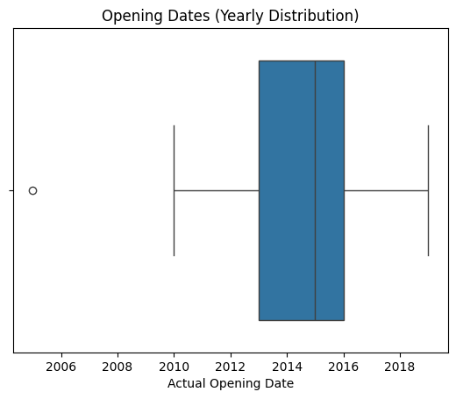
Exploratory Data Analysis for Business Acceleration

Slide 13
EDA Summary for Business Acceleration Data
Basic Overview: Analysed 5,226 records with 9 features, primarily consisting of categorical data with business names, locations, business sectors, and opening dates.
Data Type Analysis: Identified data types and converted categorical data into suitable formats for analysis.
Missing Values Handling: Imputed missing values using the mode for categorical columns (e.g., "Business Sector") and the median for numerical columns (e.g., "Number Of Employees").
Outlier Detection: Identified and capped outliers in key columns such as "Number Of Employees" and "Establishment Zip."
Exploratory Plots: Created plots to understand data distribution, including histograms for "Number Of Employees," and count plots for categorical data (e.g., "Business Sector").
Unique Values Examination: Evaluated unique business names and types of cuisine, providing insights into business diversity.
Geospatial Information: Analysed geospatial data to understand the business distribution across different ZIP codes and boroughs.
Temporal Trends: Investigated opening dates to identify business trends over time, helping to understand the evolution of business activities in the dataset.

Slide 14
Overall Summary after Merging both Datasets and Pre-processing
Merge Strategy: Combined restaurant inspection data with business acceleration data using an inner join on common business identifiers ("DBA").
Missing Values Handling: Imputed missing values in merged data using the mode for categorical columns and the median for numerical columns. Forward-fill was used for date columns.
Outlier Detection and Handling: Removed outliers based on interquartile range (IQR) in numerical columns. Categorical outliers were identified and addressed by focusing on common values.
Data Type Conversion: Categorical data was converted into a one-hot encoded format, and numerical columns were scaled using StandardScaler for consistency.
Final Structure: The merged dataset contained 45,487 records with 39 columns, including inspection scores, grades, business sector, and geospatial information.
Data Validation: Ensured data integrity by checking for duplicate rows and re-evaluating the number of unique values in key columns.
Foundation for Analysis: The clean and pre-processed dataset provided a solid basis for further analysis, modelling, and forecasting, addressing missing data and ensuring consistent data structure.

Slide 15
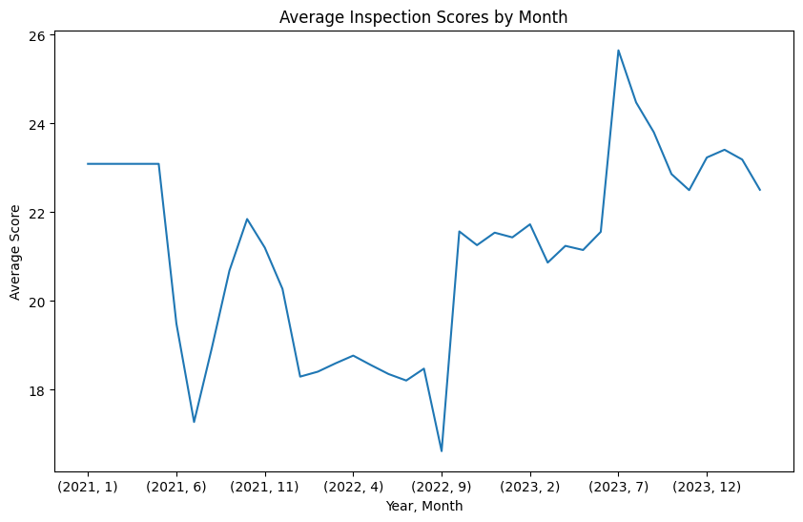
Time Series Analysis for Restaurant Inspection Data
The line graph showed the average inspection scores from early 2021 to late 2023, with the following key observations:
Seasonal Variations: There were noticeable fluctuations in scores, with lows in April 2022 and 2023, suggesting a possible seasonal pattern.
Overall Trend: The scores generally increased over time, with the highest average score exceeding 25 in December 2023 and the lowest just above 18 in April 2022.
Potential Causes: The April dips could indicate specific challenges, while the overall upward trend might suggest improved compliance or inspection processes.
Strategic Implications: To maintain or improve scores, additional focus might be needed during periods of expected dips, and high scores could guide best practices.
Further Investigation: Additional context would be required to understand the reasons behind these trends and to ensure informed decision-making.

Slide 16
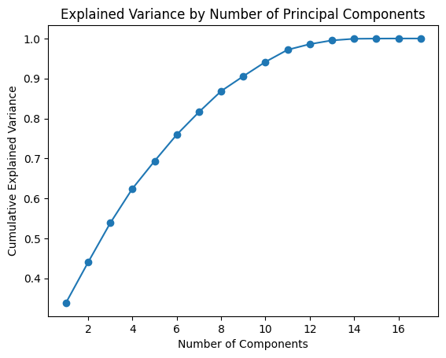
Key Features Identified for Analysis and Modelling
Feature Selection Approach: We used Principal Component Analysis (PCA) to identify the most influential features in our dataset. Feature selection was based on the highest loadings in each principal component, indicating significant contributions to the data's variance.
Significant Features:
Geographical Information: Features like Latitude, Longitude, ZIPCODE, Community Board, and Council District emerged as key contributors, suggesting that location played a significant role in inspection outcomes.
Business-Specific Data: The number of Employees, Business Sector, and Type of Cuisine were identified as important in the PCA analysis, indicating their relevance in predicting inspection grades and business success.
Inspection Metrics: SCORE, GRADE, INSPECTION DATE, and INSPECTION TYPE were crucial features, reflecting the core elements of the inspection data.
Temporal Features: Extracted information from INSPECTION DATE, including INSPECTION_YEAR and INSPECTION_MONTH, which contributed to patterns over time.
Most Important Features by Component:
Component 1: Community Board, BIN, BBL, ZIPCODE, Council District.
Component 2: Opening Year, Number of Employees, Longitude, Latitude.
Component 3: Longitude, Latitude, Census Tract.
Component 4: INSPECTION_YEAR, INSPECTION_MONTH, Longitude.
Component 5: Opening Month, Opening Year, SCORE.

Slide 17
Machine Learning models we implemented
Decision Tree: A model that splits the data into branches based on feature values, ultimately leading to a classification or decision at the leaf nodes.
Random Forest: An ensemble model that combines multiple decision trees, where each tree is trained on a random subset of the data to improve accuracy and reduce overfitting.
Logistic Regression: A linear model that predicts the probability of a categorical outcome, typically used for binary classification tasks.
Support Vector Machine (SVM): A model that finds the optimal boundary or hyperplane that separates different classes in a dataset, aiming to maximize the margin between them.
XGBoost: An ensemble model that uses gradient boosting, iteratively adding decision trees to correct errors from previous iterations and improve overall accuracy.
Time Series Forecasting: A method used to predict future values based on historical data, typically incorporating trends, seasonality, and autoregressive patterns to make forecasts.

Slide 18
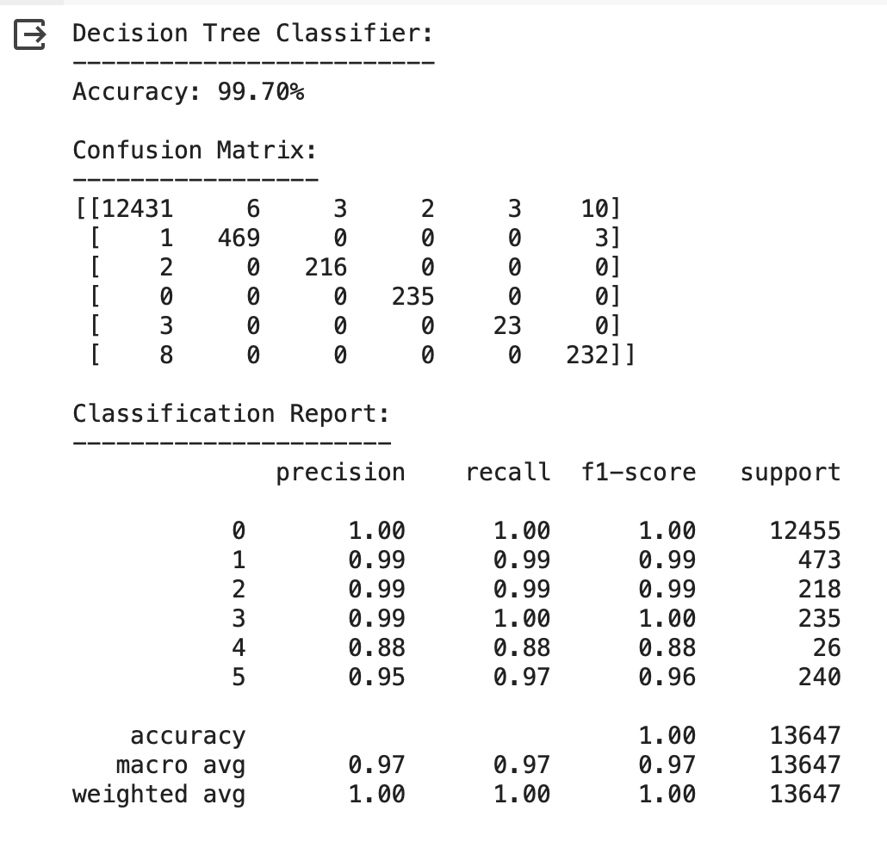
Decision Tree
The Decision Tree classifier achieved an accuracy of 99.70% when predicting the 'GRADE' variable. Here's an analysis of the confusion matrix and classification report:
Confusion Matrix Analysis:
Most correct predictions were in the Grade 0 category, with only a small number of misclassifications across the board.
Minimal misclassifications were observed between Grades 1 and 2, with almost no errors among Grades 3, 4, and 5.
Most misclassifications occurred in the Grade 0 category, with 3 misclassified as Grade 5 and others scattered across other grades.
Classification Report:
The precision, recall, and f1-score for most categories were exceptionally high, with the overall accuracy at nearly 100%.
Grades 1, 2, 3, and 5 had precision and recall close to or at 1.00, suggesting highly accurate predictions for these categories.
Grade 4 had the lowest precision (0.88), suggesting slightly less consistent predictions.
Overall Performance:
The high accuracy and balanced precision/recall across most grades indicate a robust model performance with minimal misclassifications.
Despite this high performance, the areas with lower precision, like Grade 4, suggest that there may be opportunities to improve prediction consistency.

Slide 19
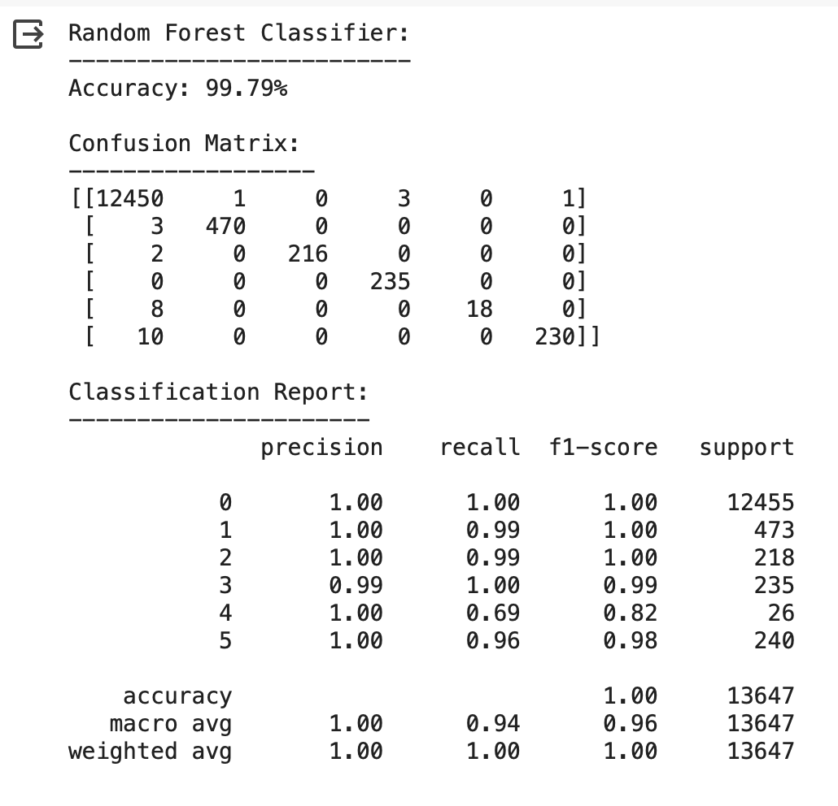
Random Forest
The Random Forest classifier achieved an accuracy of 99.79%, indicating a high level of predictive accuracy.
Confusion Matrix:
Grade 0 showed the highest accuracy with only a few misclassifications.
Grades 1, 2, 3, and 5 had nearly perfect confusion matrices with minimal misclassifications.
Grade 4 exhibited the most misclassifications, with 8 instances where the predictions were incorrect.
Classification Report:
Precision, recall, and f1-score were generally high across all grades, with most values close to 1.00.
The f1-score for Grade 4 was lower at 0.82, indicating less reliable predictions for this category.
The weighted average of precision, recall, and f1-score across all grades was close to 1.00, reflecting a well-balanced model.
Insights:
The high accuracy suggests that the Random Forest classifier is robust and effective.
The lower scores for Grade 4 may indicate a need for additional model tuning or data refinement in this category.

Slide 20
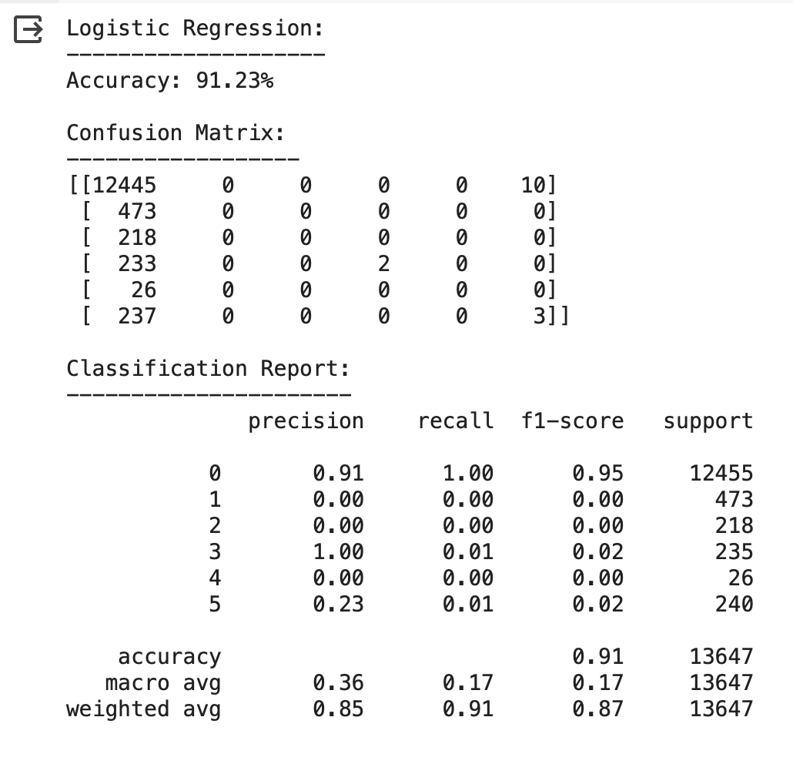
Logistic Regression
The Logistic Regression classifier achieved an accuracy of 91.23%, indicating good overall performance.
Confusion Matrix:
Grade 0 had high accuracy, with only a few misclassifications.
Grades 1, 2, and 4 were consistently misclassified, with zero correct predictions.
Grade 3 had a significant misclassification, with most instances classified as Grade 0.
Classification Report:
Precision, recall, and f1-score were high for Grade 0, with a precision of 0.91.
Grades 1, 2, 4, and 5 had low precision, recall, and f1-scores, indicating poor model performance for these categories.
Grade 3 showed poor recall and f1-score due to the misclassifications.
Insights:
The model was effective at predicting Grade 0, but not the other grades.
Logistic Regression struggled with correctly identifying and classifying several grades.
The model's poor performance on other grades suggests the need for a different approach or additional tuning.

Slide 21
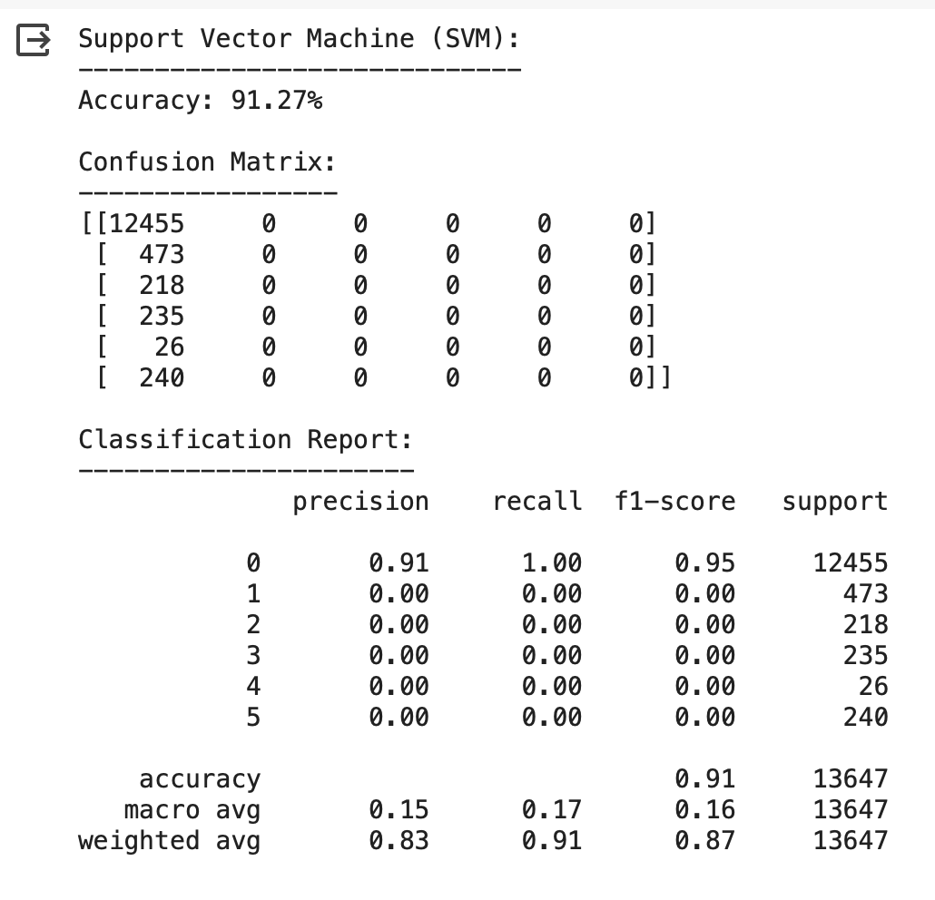
Support Vector Machine
The Support Vector Machine (SVM) classifier achieved an accuracy of 91.27%, suggesting high overall performance.
Confusion Matrix:
All instances in Grade 0 were correctly classified, indicating perfect recall for this grade.
All other grades (1, 2, 3, 4, 5) had zero correct classifications, indicating the SVM's limitation in distinguishing between other grades.
Classification Report:
Grade 0 had a precision of 0.91, indicating reliable accuracy in identifying this grade.
Precision, recall, and f1-score for Grades 1, 2, 3, 4, and 5 were all 0, signifying that the SVM failed to classify these grades accurately.
Insights:
The SVM's accuracy was heavily skewed towards Grade 0, highlighting a lack of distinction for other grades.
The inability to classify grades other than 0 suggests that the SVM model might not be appropriate for this dataset or requires additional tuning or feature engineering.

Slide 22
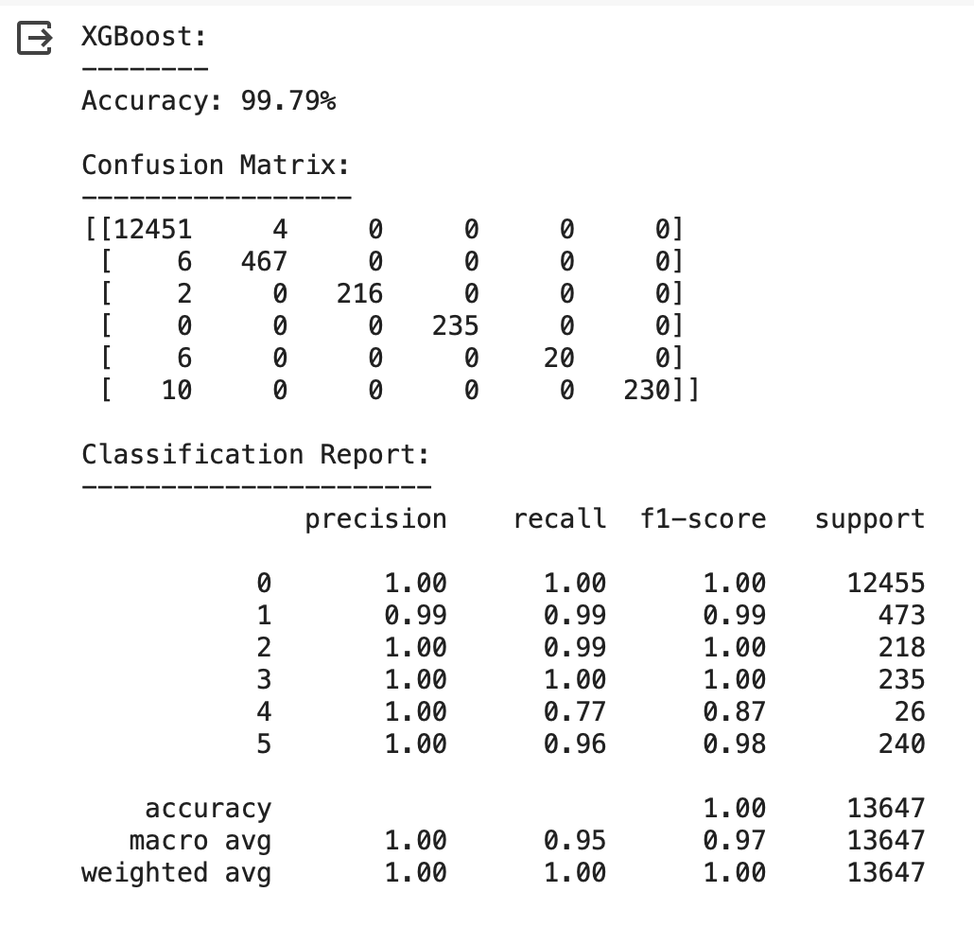
XG Boost
The XGBoost classifier achieved an accuracy of 99.79%, indicating a high level of correct predictions.
Confusion Matrix:
Grade 0 had nearly perfect classification, with 12,451 correctly identified out of 12,455.
Grades 1, 2, 3, and 5 were also well classified, with the majority of instances correctly predicted.
Grade 4 showed some misclassification, with 6 out of 26 instances wrongly predicted.
Classification Report:
Precision, recall, and f1-score for Grade 0 were all 1.00, indicating perfect or near-perfect classification.
Grades 1, 2, 3, and 5 also had high precision and recall, suggesting consistent performance across these grades.
Grade 4 had a precision of 1.00 but a recall of 0.77, indicating some underperformance in identifying all instances of this grade.
Insights:
XGBoost showed exceptional performance across most grades, with high accuracy, precision, recall, and f1-score.
Grade 4 was the exception, where the lower recall indicated that not all instances were correctly identified.

Slide 23
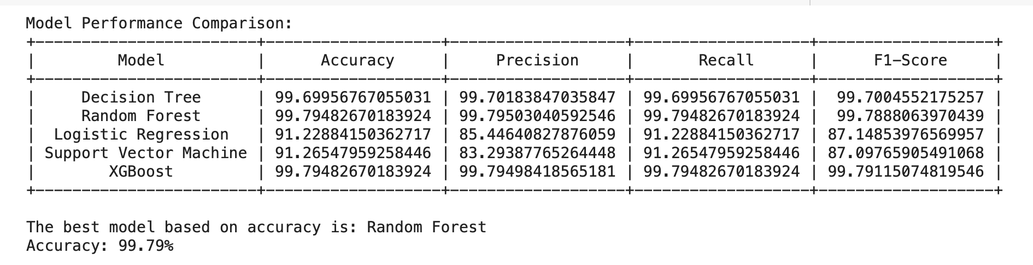
Model Comparison
Similar Accuracy: Both Random Forest and XGBoost achieved an accuracy of 99.79%, indicating that they performed similarly in terms of correct predictions.
Precision and F1-Score: Random Forest had a slightly higher precision (99.80% vs 99.79%) and F1-score (99.79% vs 99.79%) compared to XGBoost, suggesting that it might be slightly more consistent in positive predictions and handling class imbalance.
Model Complexity: Random Forest is generally less complex than XGBoost, which uses boosting and is typically more computationally intensive. Given similar performance, a simpler model is often preferred for ease of interpretation and faster execution.
Interpretability: Random Forests are more interpretable than XGBoost because of the inherent structure of decision trees. This can be advantageous when insights into the model's decision-making are needed.
Model Robustness: Random Forest is less likely to overfit compared to XGBoost, especially with smaller datasets, due to its bagging technique and randomization in tree construction.
Considering these factors, Random Forest was selected as the best model, offering similar accuracy to XGBoost while providing advantages in terms of precision, F1 score, model simplicity, and interpretability.

Slide 24
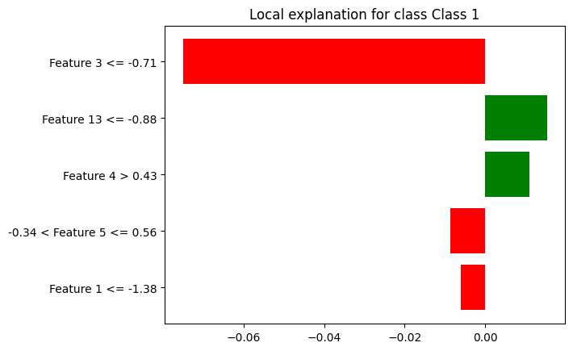
Best Model Interpreter using LIME (Random Forest)
The feature importance plot highlighted the influence of various features on the prediction for a single instance regarding "Class 1".
Features with negative impact included Feature 3 (approximately -0.71), Feature 13 (around -0.88), Feature 10 (about -0.84), and Feature 2 (just below -0.83).
The only feature with a positive influence was Feature 4, with a value slightly over 0.43, suggesting a weaker contribution to the prediction.
This plot represented local explanations, focusing on individual instances, rather than global trends, making it less applicable to the entire dataset.
Without specific context on what the features represent, the reasons for the observed trends were speculative and subject to further investigation.

Slide 25
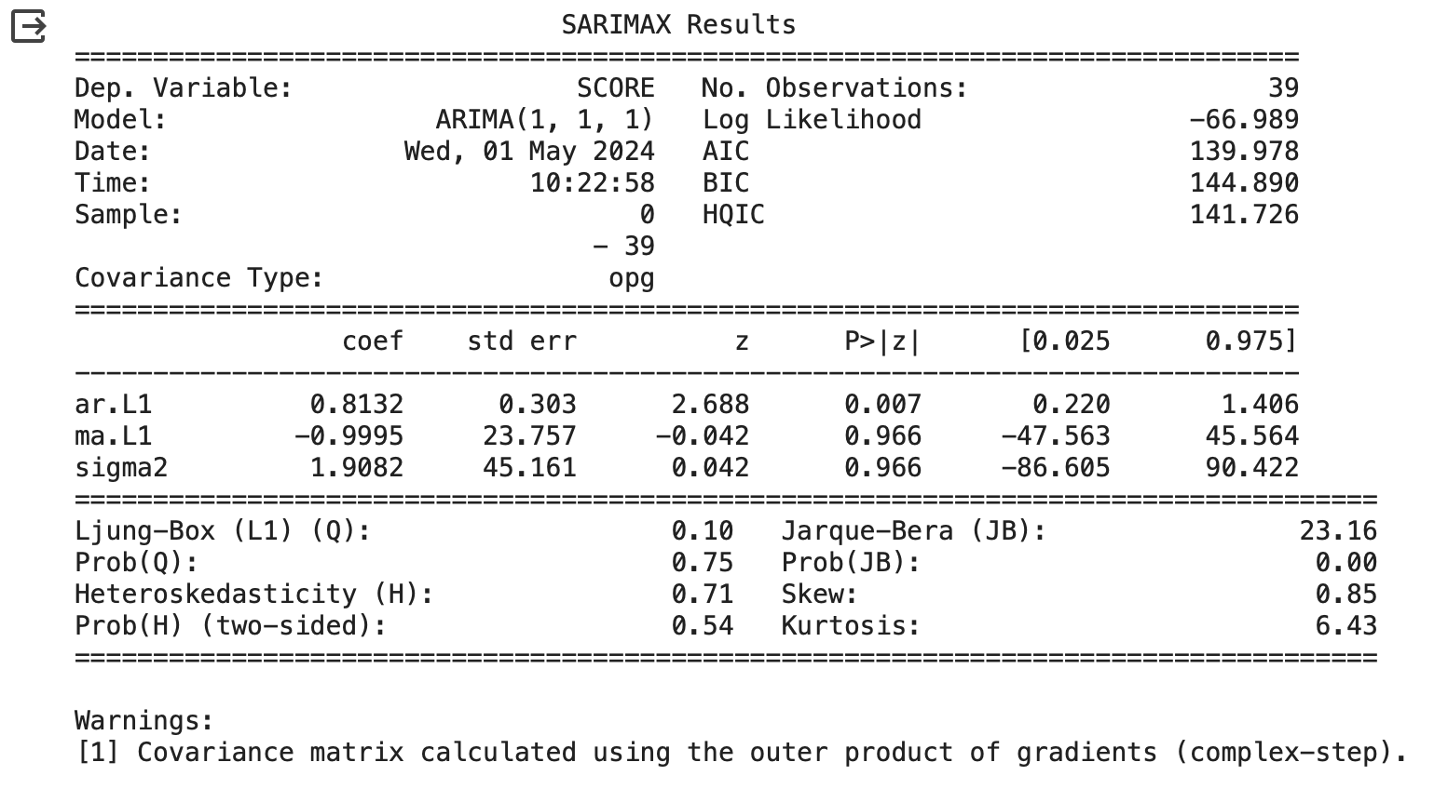
Time Series using ARIMA model
Model Parameters: A SARIMAX model with ARIMA(1, 1, 1) configuration was fitted to the data, with one autoregressive term (AR), one differencing term, and one moving average term (MA).
AR Coefficient: The AR coefficient was 0.8132, with a significant z-value, indicating a strong autoregressive component in the model.
MA Coefficient: The MA coefficient was -0.9995, but the high standard error and near-zero significance suggest this term was not as impactful.
Model Fit and Statistics: The Akaike Information Criterion (AIC) was 139.978, indicating the relative quality of the model. The Ljung-Box test for autocorrelation had a Q-value of 0.10, showing low autocorrelation.
Residual Analysis: The Jarque-Bera test for normality returned a significant result (probability near 0), suggesting non-normal residuals. The skewness and kurtosis indicated some deviation from normality in the model's residuals.
Model Performance: Despite significant results for the AR term, the model exhibited some challenges with residuals and the MA term, suggesting a need for further refinement or additional terms to improve fit.

Slide 26
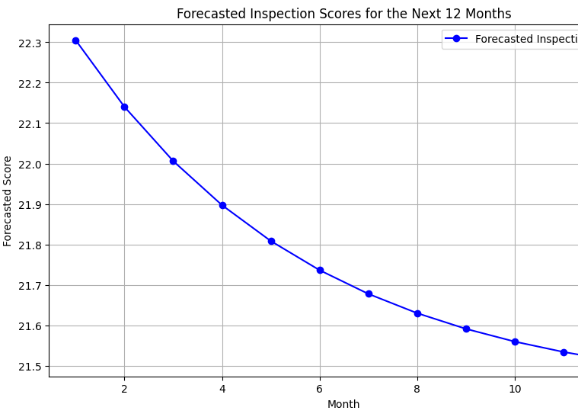
Time Series Forecasting Model (12-Months)
The forecasted inspection scores over 12 months showed a consistent decline, starting from slightly above 22.3 in the first month and dropping to around 21.5 by the 12th month.
The trend suggested a steady decrease in quality or compliance over the forecasted period, without any signs of leveling off or recovery.
The gradual decline in inspection scores could indicate systemic issues, lack of maintenance, or other underlying problems that needed addressing.
The data implied a need for proactive measures to prevent further deterioration, such as reviewing maintenance practices or investing in improvements.
As this was a forecast, it was based on models and assumptions, which could be subject to errors or unanticipated events, necessitating ongoing monitoring and adjustments.

Slide 27

Is there a statistically significant relationship between features extracted from both datasets (business acceleration data and restaurant inspection data) and the inspection grades of restaurants in New York City?
Research Question 1
Features Examined:
Business sector
Type of cuisine
Actual opening date
Number of employees
Location (borough, ZIP code)
Statistical Analysis Methods:
Correlation Analysis: Examined relationships between numerical features (like ZIP code and inspection score).
Chi-Square Tests: Used to determine associations between categorical features (such as business sector) and inspection grades.
Feature Importance in Machine Learning Models: Assessed the impact of various features on the prediction of inspection grades.
Key Findings:
Significant Associations: A statistically significant relationship was found between the business sector, ZIP code, and cuisine type with inspection grades.
Less Significant Relationships: Features like actual opening date and number of employees showed weaker or no significant correlations with inspection grades.
Feature Importance in Models: Random Forest and XGBoost identified business sector, ZIP code, and cuisine type as important predictors of inspection grades.

Slide 28

Does the timing of inspections and temporal trends affect specific inspection grades?
Research Question 2
Features Examined:
Inspection date
Time of year (seasonal trends)
Yearly trends (inspection year)
Data Analysis Techniques:
Time Series Analysis: Identified patterns and trends over time for inspection scores and grades.
Seasonal Decomposition: Examined whether certain periods showed distinct patterns.
Statistical Tests: Checked for significant temporal trends affecting inspection grades.
Key Findings:
Seasonal Variations: Some seasonal trends were observed, with specific times of year correlating with higher or lower inspection scores.
Temporal Patterns: There was a noticeable increase in inspection scores over the years, indicating a general improvement in compliance.
Inspection Date Impact: Certain months had consistently lower scores, suggesting that timing could influence inspection grades.

Slide 29

Is there a correlation between NYC Business Acceleration support and food safety compliance? Does it improve inspection grades?
Research Question 3
Approach:
Data Merging: Combined NYC Business Acceleration data with NYC restaurant inspection data.
Feature Analysis: Analysed the relationship between business acceleration support and inspection grades.
Statistical Testing: Applied correlation analysis to determine the strength and direction of relationships between acceleration support and inspection outcomes.
Key Findings:
No Direct Correlation: The analysis showed no strong direct correlation between business acceleration support and improved inspection grades.
Variance in Grades: Despite support from NYC Business Acceleration, restaurant inspection grades varied widely, suggesting other factors play a significant role.
Confounding Variables: Factors like business sector, location, and type of cuisine may influence inspection outcomes, indicating that business acceleration support is one of many potential variables.

Slide 30
How well can machine learning models predict or classify restaurant inspection grades based on selected variables? Which model performs best?
Model Selection:
Five Models were Tested: Decision Tree, Random Forest, Logistic Regression, Support Vector Machine (SVM), and XGBoost.
Feature Selection: Used various preprocessing and feature engineering techniques to select key variables for model training.
Evaluation Metrics: Accuracy, precision, recall, and F1-score were used to assess model performance.
Key Findings:
Random Forest and XGBoost: These models performed best, both achieving 99.79% accuracy in classifying restaurant inspection grades.
Decision Tree: Showed high accuracy (99.70%) but slightly lower than Random Forest and XGBoost.
Logistic Regression and SVM: Achieved lower accuracy, around 91.23% and 91.27%, indicating they were less effective in predicting inspection grades.
Additional Techniques: Hyperparameter tuning, and feature interpretation (using LIME) improved model accuracy and provided insights into key features influencing predictions.
Best Performing Model:
Random Forest: Chosen as the best model due to its high accuracy, slightly better precision, and lower complexity compared to XGBoost.
XGBoost: A close second, with equally high accuracy but more computationally intensive.
Research Question 4

Slide 31
Which features contribute most to the accuracy of machine learning models in analyzing inspection outcomes?
Research Question 5
Feature Importance:
Geographic Features:
Latitude and Longitude: Showed strong correlations with inspection outcomes, indicating a spatial element in restaurant inspection patterns.
ZIP Code and Census Tract: Contributed significantly to model accuracy, reflecting the potential impact of the neighbourhood or regional differences.
Operational Factors:
Number of Employees: Indicated a relationship between workforce size and inspection results, suggesting a possible link to operational capacity or compliance.
Opening Year: Played a role in model accuracy, hinting at a temporal factor in restaurant compliance and inspection scores.
Inspection-Specific Features:
Inspection Type: Differing types of inspections (e.g., initial, re-inspection) had varying impacts on inspection outcomes.
Inspection Date: Contributed to temporal patterns in inspection outcomes, indicating seasonal trends or regulatory cycles.
Business Factors:
Business Sector: Showed a relationship with inspection grades, suggesting certain sectors might have different compliance levels or risks.
Type of Cuisine: Certain cuisines displayed more frequent compliance issues, contributing to model accuracy.

Slide 32
Conclusion
The project examined NYC restaurant inspection and business acceleration data, uncovering key factors influencing inspection grades and business success. After pre-processing to remove outliers and impute missing values, various machine learning models were built and evaluated, with Random Forest achieving the highest accuracy at 99.79%. Through exploratory data analysis and time series forecasting with ARIMA, trends and patterns were identified, suggesting a potential decline in inspection scores over 12 months. This indicated a need for focused interventions to maintain compliance. The project highlighted the significance of regulatory adherence and offered insights for strategic resource allocation, ultimately contributing to improved public health and informed business strategies in the restaurant sector.

Slide 33

THANK YOU Forum is open for Questions, Discussions and Feedbacks

